Slide 1

TECH4POSITIVE FUTURES
HACKATHON FOR TECH MINDS Innovation for better tomorrow 4th- 8th October

Slide 2
Providing Inclusive work environment for people in the autism spectrum Team Ummeed Ashish Kaul Sangeetha SelvakumaR Vignesh J Nithya Sagar Naveen roopali
1

Slide 3
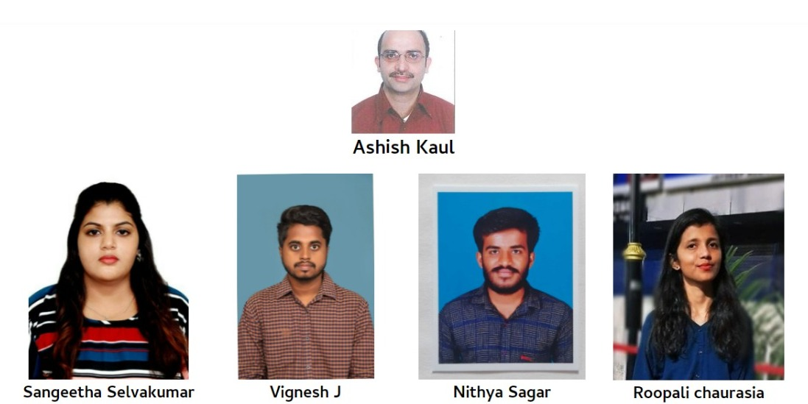

Slide 4
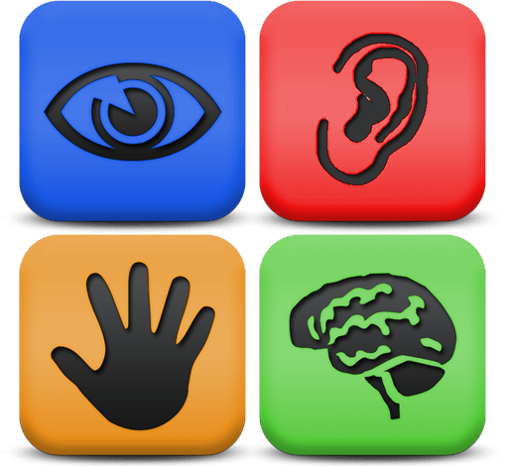
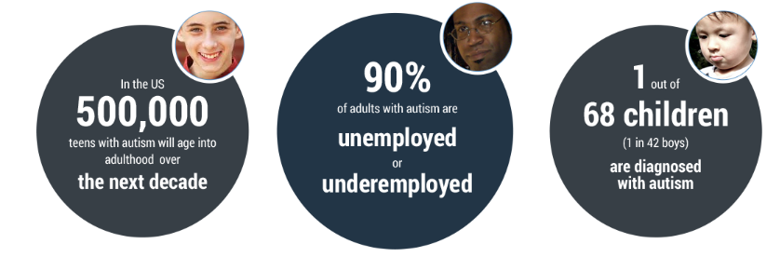
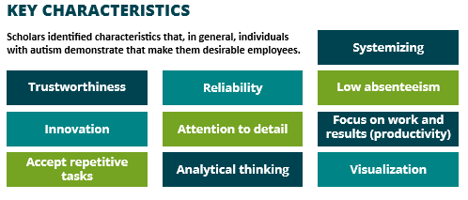

CURRENT SCENARIO
Currently, there are many potential barriers for neurodivergent people to work in the corporate workplace environment. They are not easily welcomed due to lack of tools and available resources to communicate or understand things efficiently.
.
Info Source (Autism@Work Playbook)
Our idea here is to come up with a concept tool having accessibility features that will focus on the removal of potential barriers such that neurodivergent people can contribute in the workplace, with their skillset bypassing those barriers.

Slide 5

Why this SCENARIO ? - Problem Statement

Slide 6


Table of contents
Neurodiversity
Introduction – The Future is Inclusive
Tools Proposed
Interview App
Meeting App

Slide 7
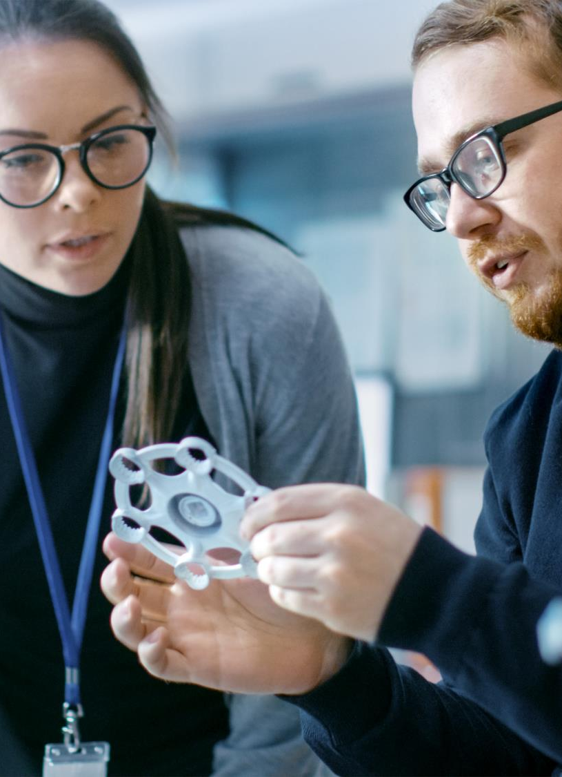
Neurodiversity - Definition
It is an umbrella term that encompasses neurocognitive differences such as autism, attention deficit hyperactivity disorder (ADHD), dyslexia, Tourette’s syndrome, anxiety, obsessive-compulsive disorder, depression, intellectual disability and schizophrenia, as well as ‘normal’ neurocognitive functioning, or neurotypicality. Neurodivergent individuals are those whose brain functions differ from those who are neurologically typical, or neurotypical..

Slide 8
Introduction – The Future is Inclusive
Potential Barriers
Acceptibility and Trust
Too much information from
diverse sources
Difficult to understand, read &
analyze complex data.
Difficult to adapt to
unpredictable scenarios.
Our Solution
Web and mobile based App
Salient Features
Inclusive and minimalistic design
Inclusive Caption for voice to text conversion
Suggestive text/reply using Machine learning
Solution Design Principle
People in Neurodivergent spectrum
like to work in well-defined schedules
(structure and predictability).
They are mostly visual learners,
Any Communication to be done in Simple
And visual language
Value Proposition
Companies can hire resources without compromising on quality.
Better intra and inter team interaction not only within organization but with Customers and Vendors as well

Slide 9
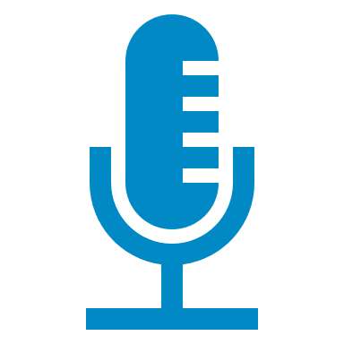



Potential barriers addressed by tool
Interview Process
Virtual Meetings
Notes - Reminders
Unable to read, remember and analyze
End to end solution for scheduling and conducting interviews.
Potential benefits to Interviewee and Interviewer .
End to end solution for attending virtual meetings in audio, video and virtual reality mode.
Will benefit Project teams within the organization and can be used with Clients
Tool uses AI in order to send meeting notes directly to mailbox.
Visual Reminders.
Identify behavioral pattern of team members via AI such that all are can see behavior patterns
Live Meeting text and audio transcription with visuals.
Potential benefits also to hearing/visually impaired people.
Neurodivergent people are not different, but they think differently

Slide 10





Autism Scenario – Interview Process
Interview Schedule
Interview Preference
Sensory Needs
Interview Topic
Interviewer
Sonali Singh

Slide 11







Autism Scenario – Interview Process
Ashish’s Visual Calendar
Interview Schedule
4 Oct
Interview Preference
Video
Type
 |  | Breakfast
 |  | Games Practice
 |  | Lunch
 |  | Interview
Sensory Needs
Project
Interview Topic
Interviewer
Sonali Singh

Slide 12

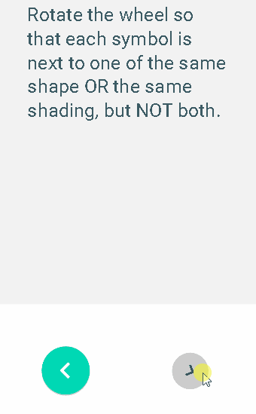









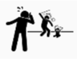


Gamified Assessment Topics
Shape Spinner
Pipe Puzzle
Find the errors
Says “Need ➕ ⌚?”
Finish
Yes
Need
Repeat
Stop
Report Abuse
Wait
Ashish’s Screen during interview

Slide 13
Autism Scenario – Virtual Team Meeting
A host plays ▶️ a ❗️ important in any meeting🤝.
Meeting 🤝 planner should provide options for the host to fully control 🎛️ the meeting 🤝 with smart controls 🎛️ and ➕ topics.
The host should plan the topics and ➕ duration of the meeting 🤝 with more details to support inclusive discussion, so that others comes well prepared for the meeting 🤝
Using Inclusive content, as much as possible during meeting 👤🤝👤.

Slide 14
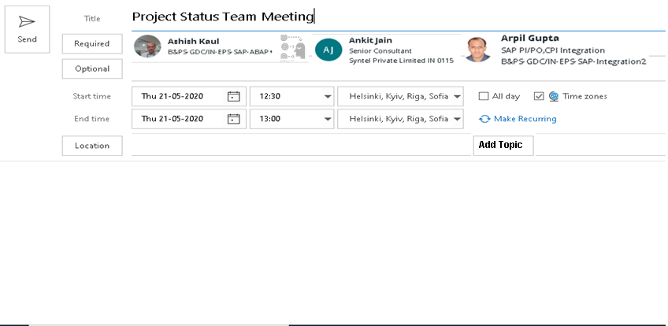





UNICOM Meeting Planner
Listeners
Circuit
T1: Go-live 📅.
: Arpil to align with client.
Circuit Topic
Add People
T2: App Testing
:Ashish Need
Circuit Topic
Add People
Circuit Topic
Add People
Questions?
Circuit Topic
Add People

Slide 15









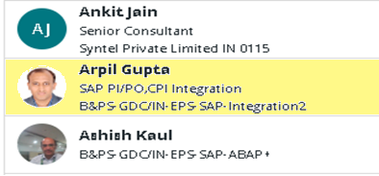








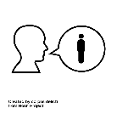
Current Topic 1(4)
T1:Go-live 📅
T1: Go-live 📅.
: Arpil to align with client.
T2: App Testing
T3: Support Handover..
T2: App Testing
:Ashish Need
T4:Conclusion
Skip
Participants(15)
T3: Support Handover
Next
T4:Conclusion
Says: "Production on 30/09/2020”
Repeat
Stop
No Sound
Req. to
Speak
Ashish’s Personalized Screen while in Team Meeting

Slide 16
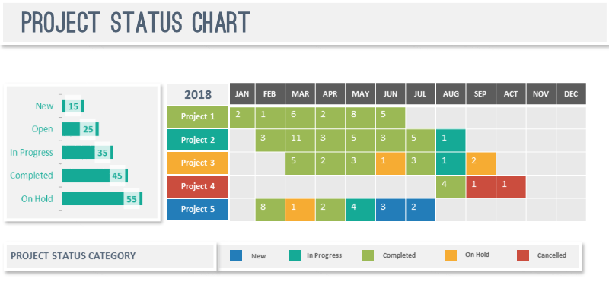
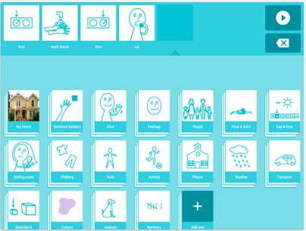
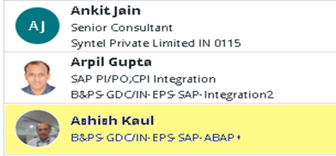


Current Topic 1(4)
T1:Go-live 📅
T2: App Testing
T3: Support Handover..
T4:Conclusion
Participants(15)
Says: did 👉 complete Task 11?
Yes
Need
Repeat
Stop
No Sound
Req. to
Speak
Ashish’s Personalized Screen while in Team Meeting

Slide 17





HOW TO IMPLEMENT?
Teams Plugin
Use Teams/Skype as a base , start with develop a accessibility plugin , firstly for neurocognitive differences like autism as baseline followed with some trails and further extended to other areas as well with additional plugins for the sensory needs of the special employee and making future more inclusive workplace.
Important areas
Symbol-based predictive Visual keyboard with native language can be integrated using SwiftKey Symbols.
Live visual caption/subtitles can be developed using emoji translator services.
Smart Reply to assist non verbal communication by predicting responses using NLP and ML.
Future VR Mode
VR mode can be developed in future to attend meeting from circuit for more immersive experience based on:
1. Personalization as per accessibility
2. Adaption to accessibility using Augmented Reality interactive controls.

Slide 18
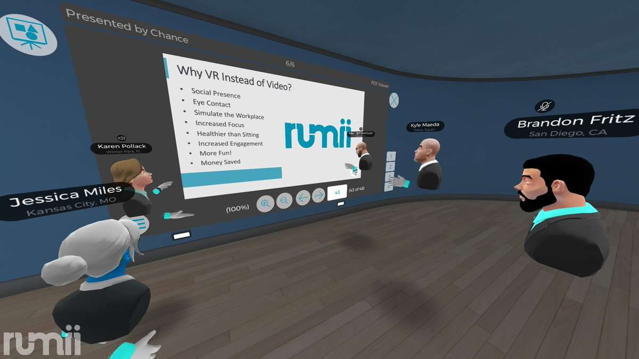
T1: Go Live Date.
: Arpil to align with client.
T2: App Testing
:Ashish Need
T3: Support Handover
T4:Conclusion

